Slide 1
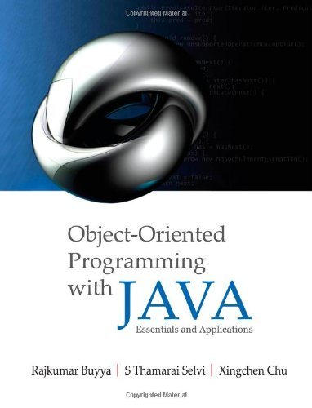
OS Support for Building Distributed Applications: Multithreaded Programming using Java Threads
Presented by Dr. Anas Youssef
Lectures made by Dr. Rajkumar Buyya
Cloud Computing and Distributed Systems (CLOUDS) Laboratory
School of Computing and Information Systems
The University of Melbourne, Australia

Slide 2
Outline
Introduction to Middleware
Thread Applications
Defining Threads
Java Threads and States
Architecture of Multithreaded servers
Threads Synchronization
Summary

Slide 3
Introduction
Middleware is a layer of software (system) between Applications and Operating System (OS) powering the nodes of a distributed system.
The OS facilitates:
Encapsulation and protection of resources inside servers;
Invocation of mechanisms required to access those resources including concurrent access/processing.
Applications
Middleware
Distributed Nodes with OS

Slide 4
Middleware and Network Operating System (NOS)
Many DOS (Distributed OS) have been investigated, but there are none in general/wide use. But NOS are in wide use for various reasons both technical and non-technical.
Users have much invested in their application software; they will not adopt a new OS that will not run their applications.
Users tend to prefer to have a degree of autonomy of their machines, even in a closely knit organisation.
A combination of middleware and NOSs provides an acceptable balance between the requirement of autonomy and network transparency.
NOS allows users to run their favorite word processor.
Middleware enables users to take advantage of services that become available in their distributed systems.

Slide 5






Introducing a middleware
Building Distributed Systems
DOS or NOS are not enough to build a DS!
NOS are a good starting point but ….
… we need an additional layer “gluing” all together
Middleware
NOS
Notes:
You can decide the best networking protocol to use (e.g. TCP/UDP), the best and most efficient message format, and how to optimally store the dictionary for fast lookups.

Slide 6
Building Distributed Systems
Middleware
High-level features for DS
Communication
Management
Application specific
Uniform layer where to build DS services
Runtime environment of applications
Operating System
Low / medium level (core) features
Process / threads management
Local hardware (CPU, disk, memory)
Security (users, groups, domain, ACLs)
Basic networking

Slide 7
Operating system layers and Middleware
Unix and Windows are two examples of Network Operating Systems – have a networking capability built into them and so can be used to access remote resources using basic services such as rlogin, telnet.

Slide 8
Core OS components and functionality

Slide 9
Threaded Applications
Modern Applications & Systems
Operating System Level
Multitasking: multiple applications running at once
Application Level
Multithreading: multiple operations performed at the same time
Bottom Line:
Illusion of concurrency
Notes:
Upon completion, a graduate of the program should have:
*expertise in Internet programming and distributed computing,
*be able to apply acquired techniques and knowledge to contribute to the development and implementation of enterprise software systems,
*be able to analyse and design ICT projects and future ICT needs, and
*be able to apply Internet-based distributed computing systems and algorithms to e-Science and e-Business applications.

Slide 10










Threaded Applications
Modern Systems
Multiple applications run concurrently!
This means that… there are multiple processes on your computer
games
web & email
office automation
multimedia
pictures
Multitasking
Notes:
GRIDS Lab is located ….

Slide 11
A single threaded program
class ABC
{
….
public void main(..)
{
…
..
}
}
begin
body
end

Slide 12





Threaded Applications
Modern Systems
Applications perform many tasks at once!
This means that… there are multiple threads within a single process.
Background printing
GUI rendering
Application core logic

Slide 13
A Multithreaded Program
Main Thread
start
start
start
Thread A
Thread B
Thread C
Threads may switch or exchange data/results

Slide 14
Single and Multithreaded Processes
threads are light-weight processes within a process
Single-threaded Process
Multi-threaded Process
Threads of
Execution
Single instruction stream
Multiple instruction stream
Common
Address Space

Slide 15




Multithreaded Server: For Serving Multiple Clients Concurrently
Modern Applications
Example: Multithreaded Web Server
Process Request Client 1
Web/FTP
server
Process Request Client 2
Client 1
Process Request Client N
Client 2
Client N

Slide 16

Threaded Applications
Modern Applications
Example: Internet Browser + Youtube
Video Streaming
Favorities, Share,
Comments Posting

Slide 17
Modern Applications need Threads (ex1): Editing and Printing documents in background.
Printing Thread
Editing Thread

Slide 18
Multithreaded/Parallel File Copy
reader()
{
- - - - - - - - - -
lock(buff[i]);
read(src,buff[i]);
unlock(buff[i]);
- - - - - - - - - -
}
writer()
{
- - - - - - - - - -
lock(buff[i]);
write(src,buff[i]);
unlock(buff[i]);
- - - - - - - - - -
}
buff[0]
buff[1]
Cooperative Parallel Synchronized Threads

Slide 19
Defining Threads
Applications – Threads are used to perform:
Parallelism and concurrent execution of independent tasks / operations.
Implementation of reactive user interfaces.
Non blocking I/O operations.
Asynchronous behavior.
Timer and alarms implementation.

Slide 20
Defining Threads
Example: Web/FTP Server
Main Thread
while <running>
{
<wait for request>
<create a new worker thread>
<start the thread>
}
<request 1>
Web/FTP
server
Execution Timeline
Worker
Thread
<request 2>
<request N>
Worker
Thread
Worker
Thread

Slide 21
Defining Threads
Summing Up
A Thread is a piece of code that runs in concurrent with other threads.
Each thread is a statically ordered sequence of instructions.
Threads are used to express concurrency on both single and multiprocessors machines.
Programming a task having multiple threads of control – Multithreading or Multithreaded Programming.

Slide 22
Java Threads
Java has built in support for Multithreading
Synchronization
Thread Scheduling
Inter-Thread Communication:
currentThread start setPriority
yield run getPriority
sleep stop suspend
resume
Java Garbage Collector is a low-priority thread.

Slide 23
Java Threading Mechanisms...
Create a class that extends the Thread class
Create a class that implements the Runnable interface
Thread
Runnable
Thread
MyThread
MyClass
(objects are threads)
(objects with run() body)
[a]
[b]

Slide 24
1st method: Extending Thread class
Create a class by extending Thread class and override run() method:
class MyThread extends Thread
{
public void run()
{
// thread body of execution
}
}
Create a thread:
MyThread thr1 = new MyThread();
Start Execution of threads:
thr1.start();
Create and Execute:
new MyThread().start();

Slide 25
An example
class MyThread extends Thread {
public void run() {
System.out.println(" this thread is running ... ");
}
}
class ThreadEx1 {
public static void main(String [] args ) {
MyThread t = new MyThread();
t.start();
}
}

Slide 26
2nd method: Threads by implementing Runnable interface
Create a class that implements the interface Runnable and override run() method:
class MyThread implements Runnable
{
.....
public void run()
{
// thread body of execution
}
}
Creating Object:
MyThread myObject = new MyThread();
Creating Thread Object:
Thread thr1 = new Thread( myObject );
Start Execution:
thr1.start();

Slide 27
An example
class MyThread implements Runnable {
public void run() {
System.out.println(" this thread is running ... ");
}
}
class ThreadEx2 {
public static void main(String [] args ) {
Thread t = new Thread(new MyThread());
t.start();
}
}

Slide 28
Thread Class versus Runnable Interface
By extending the thread class
the derived class itself is a thread object and it gains full control over the thread life cycle.
Implementing the Runnable interface
does not give developers any control over the thread itself, as it simply defines the unit of work that will be executed in a thread.

Slide 29
Thread Class versus Runnable Interface
when extending the Thread class,
derived class cannot extend any other base classes because Java only allows single inheritance.
By implementing the Runnable interface,
the class can still extend other base classes if necessary.

Slide 30
Life Cycle of Thread
new
start()
I/O completed
ready
resume()
Time expired/ interrupted
notify()
sleeping
blocked
waiting
dispatch
sleep()
wait()
suspend()
running
Block on I/O
completion
stop()
dead

Slide 31
Example 1: MathServer – Demonstrates the use of Threads
MathThreads
p = sin (x) + cos (y) + tan (z)
A Client Program
What is p(4,5,16)?
A Client Program
What is p(4,80,16)?
What is p(4,5,16)?
Notes:
To illustrate creation of multiple threads in a program performing concurrent operations, let us consider the processing of the following mathematical equation: p = sin (x) + cos (y) + tan (z)

Slide 32
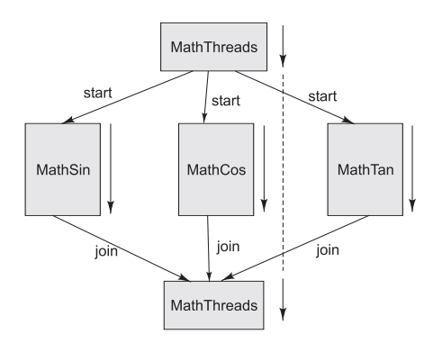
Flow of control in a master and multiple workers threads application
Notes:
The main/default thread is called MathThreads, which acts like a master thread. It creates three worker threads (MathSin, MathCos, and MathTan) and assigns them to compute values for different data inputs. All three worker threads are concurrently executed on shared or dedicated CPUs depending on the type of machine. Although the master thread can continue its execution, in this case, it needs to make sure that all operations are completed before combining individual results. This is accomplished by waiting for each thread to complete by invoking join() method associated with each worker thread. A complete Java program illustrating this concept is given in Program 14.3

Slide 33
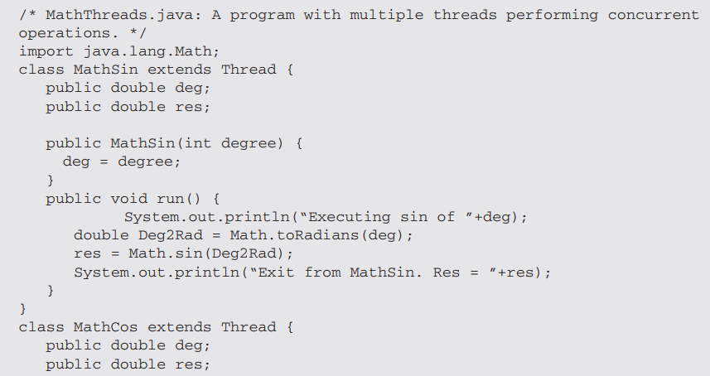

Slide 34
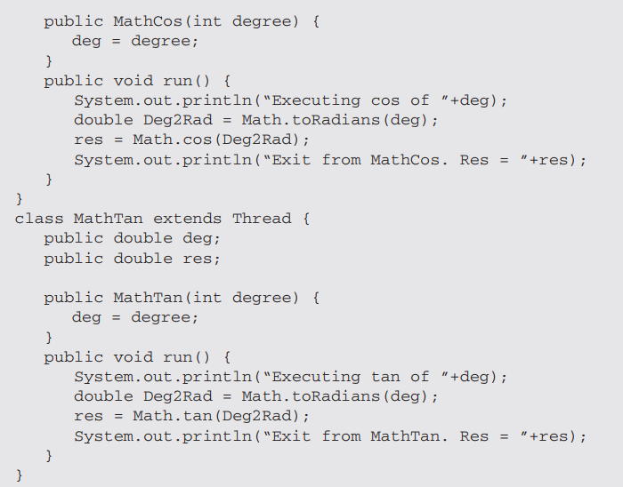

Slide 35
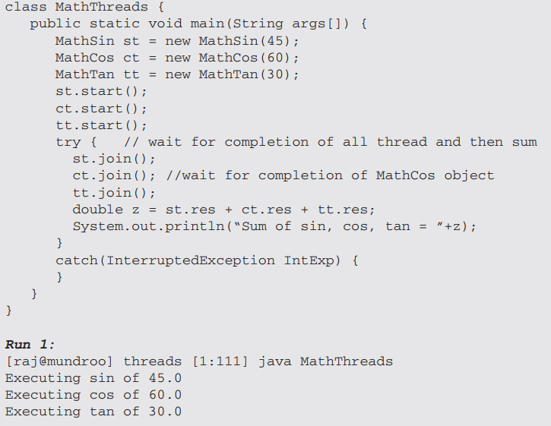

Slide 36
A Program with Three Java Threads
Write a program that creates 3 threads

Slide 37
Three threads example
class A extends Thread
{
public void run()
{
for(int i=1;i<=5;i++)
{
System.out.println("\t From ThreadA: i= "+i);
}
System.out.println("Exit from A");
}
}
class B extends Thread
{
public void run()
{
for(int j=1;j<=5;j++)
{
System.out.println("\t From ThreadB: j= "+j);
}
System.out.println("Exit from B");
}
}

Slide 38
Three threads example
class C extends Thread
{
public void run()
{
for(int k=1;k<=5;k++)
{
System.out.println("\t From ThreadC: k= "+k);
}
System.out.println("Exit from C");
}
}
class ThreadTest
{
public static void main(String args[])
{
new A().start();
new B().start();
new C().start();
}
}

Slide 39
Run 1
[raj@mundroo] threads [1:76] java ThreadTest
From ThreadA: i= 1
From ThreadA: i= 2
From ThreadA: i= 3
From ThreadA: i= 4
From ThreadA: i= 5
Exit from A
From ThreadC: k= 1
From ThreadC: k= 2
From ThreadC: k= 3
From ThreadC: k= 4
From ThreadC: k= 5
Exit from C
From ThreadB: j= 1
From ThreadB: j= 2
From ThreadB: j= 3
From ThreadB: j= 4
From ThreadB: j= 5
Exit from B

Slide 40
Run 2
[raj@mundroo] threads [1:77] java ThreadTest
From ThreadA: i= 1
From ThreadA: i= 2
From ThreadA: i= 3
From ThreadA: i= 4
From ThreadA: i= 5
From ThreadC: k= 1
From ThreadC: k= 2
From ThreadC: k= 3
From ThreadC: k= 4
From ThreadC: k= 5
Exit from C
From ThreadB: j= 1
From ThreadB: j= 2
From ThreadB: j= 3
From ThreadB: j= 4
From ThreadB: j= 5
Exit from B
Exit from A

Slide 41
Thread Priority
In Java, each thread is assigned priority, which affects the order in which it is scheduled for running. The threads so far had same default priority (NORM_PRIORITY) and they are served using FCFS policy.
Java allows users to change priority:
ThreadName.setPriority(intNumber)
MIN_PRIORITY = 1
NORM_PRIORITY=5
MAX_PRIORITY=10

Slide 42
Thread Priority Example
class A extends Thread
{
public void run()
{
System.out.println("Thread A started");
for(int i=1;i<=4;i++)
{
System.out.println("\t From ThreadA: i= "+i);
}
System.out.println("Exit from A");
}
}
class B extends Thread
{
public void run()
{
System.out.println("Thread B started");
for(int j=1;j<=4;j++)
{
System.out.println("\t From ThreadB: j= "+j);
}
System.out.println("Exit from B");
}
}

Slide 43
Thread Priority Example
How does
the order go?
class ThreadPriority
{
public static void main(String args[])
{
A threadA=new A();
B threadB=new B();
C threadC=new C();
threadC.setPriority(Thread.MAX_PRIORITY);
threadB.setPriority(threadA.getPriority()+1);
threadA.setPriority(Thread.MIN_PRIORITY);
System.out.println("Started Thread A");
threadA.start();
System.out.println("Started Thread B");
threadB.start();
System.out.println("Started Thread C");
threadC.start();
System.out.println("End of main thread");
}
}
Notes:
The priority values reflect
C
B
A

Slide 44
Thread Priority Example
Started Thread A Started Thread B Started Thread C Thread B started End of main thread Thread C started From ThreadC: k= 1 From ThreadC: k= 2 From ThreadC: k= 3 From ThreadC: k= 4 Exit from C From ThreadB: j= 1 From ThreadB: j= 2 From ThreadB: j= 3 From ThreadB: j= 4 Exit from B Thread A started From ThreadA: i= 1 From ThreadA: i= 2 From ThreadA: i= 3 From ThreadA: i= 4 Exit from A
Notes:
The priority values reflect
C
B
A
The highest priority thread C is scheduled/executed first and the thread A which has the lowest priority is scheduled last.

Slide 45
Thread Operations
public static void sleep(long millis) throws InterruptedException
The code below puts the thread in sleep state for 3 minutes
try { // thread sleeps for 3 minutes
Thread.sleep(3 * 60 * 1000); } catch(InterruptedException ex){}
Notes:
The sleep() method causes the current thread to sleep for a specified amount of time in milliseconds:

Slide 46
Thread Operations
public static void yield()
public final boolean isAlive()
void join() void join(long millis) void join(long millis, int nanos)
Notes:
The yield() method causes the current thread to move from the running state to the RUNNABLE state, so that other threads may get a chance to run. However, the next thread chosen for running might not be a different thread:
The isAlive() method returns true if the thread upon which it is called has been started but not moved to the dead state: When a thread calls join() on another thread, the currently running thread will wait until the thread it joins with has completed. It is also possible to wait for a limited amount of time instead for the thread completion.

Slide 47
Socket-based Math Server

Slide 48
Socket-based Math Server
Return to Chapter 13: Socket Programming, Section 13.5
Notes:
The multithreaded math server extends the math server from the previous Socket chapter, it enables the math server to concurrently accept client requests and to open a new thread for each socket connection by implementing the java.lang.Runnable interface. The following code shows how it is implemented

Slide 49
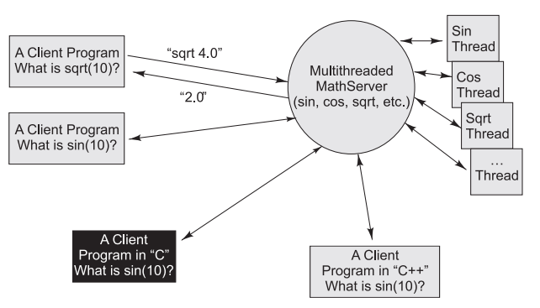
Multi-threaded Math Server
Notes:
The multithreaded math server extends the math server from the previous Socket chapter, it enables the math server to concurrently accept client requests and to open a new thread for each socket connection by implementing the java.lang.Runnable interface. The following code shows how it is implemented

Slide 50
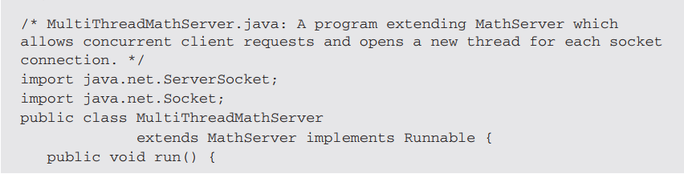
Multi-threaded Math Server
Notes:
The multithreaded math server extends the math server from the previous Socket chapter, it enables the math server to concurrently accept client requests and to open a new thread for each socket connection by implementing the java.lang.Runnable interface. The following code shows how it is implemented

Slide 51
Multi-threaded Math Server
How about
the client code?
Notes:
As can be seen from the program, the run method just invokes the execute method from the base MathServer class. The main method of the MultiThreadMathServer has a infinite while loop when a client request comes, it creates a new instance of the MultiThreadMathServer class and starts it as a separate thread.
How about the client code?
There is no need to change the client code as the multithreaded version of the Math service is totally transparent to the client. The purpose of implementing a multithreaded math server is to enable concurrent client connections, which means it now can support multiple clients at the same time compared with the single thread version.

Slide 52
Accessing Shared Resources
Applications access to shared resources need to be coordinated.
Printer (two person jobs cannot be printed at the same time)
Simultaneous operations on your bank account.
Can the following operations be done at the same time on the same account?
Deposit()
Withdraw()
Enquire()

Slide 53
Online Bank: Serving Many Customers and Operations
Internet
Bank Server
Client 1
Bank Operator 1
Bank Local Area Network
Client 2
Bank Operator M
Client N
Bank Database

Slide 54
Shared Resources
If one thread tries to read the data and another thread tries to update the same data, it leads to inconsistent state.
This can be prevented by synchronising access to the data.
Use “synchronized” keyword:
public synchronized void update()
{
…
}

Slide 55
3 Threads sharing the same object
class InternetBankingSystem {
public static void main(String [] args ) {
Account accountObject = new Account ();
Thread t1 = new Thread(new MyThread(accountObject));
Thread t2 = new Thread(new YourThread(accountObject));
Thread t3 = new Thread(new HerThread(accountObject));
t1.start();
t2.start();
t3.start();
// DO some other operation
} // end main()
}

Slide 56
Shared account object between 3 threads
class MyThread implements Runnable {
Account account;
public MyThread (Account s) { account = s;}
public void run() { account.deposit(); }
} // end class MyThread
class YourThread implements Runnable {
Account account;
public YourThread (Account s) { account = s;}
public void run() { account.withdraw(); }
} // end class YourThread
class HerThread implements Runnable {
Account account;
public HerThread (Account s) { account = s; }
public void run() {account.enquire(); }
} // end class HerThread
account
(shared object)

Slide 57
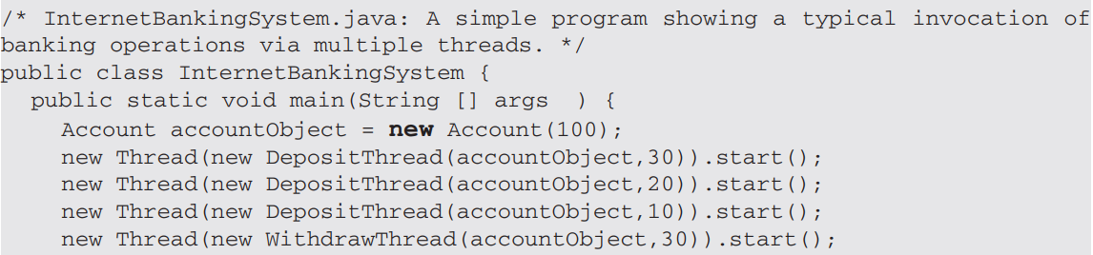
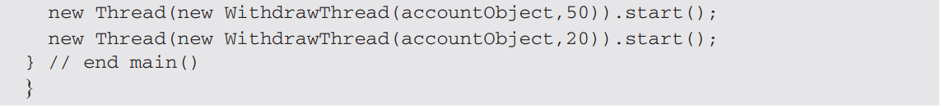
6 Threads sharing the same object

Slide 58
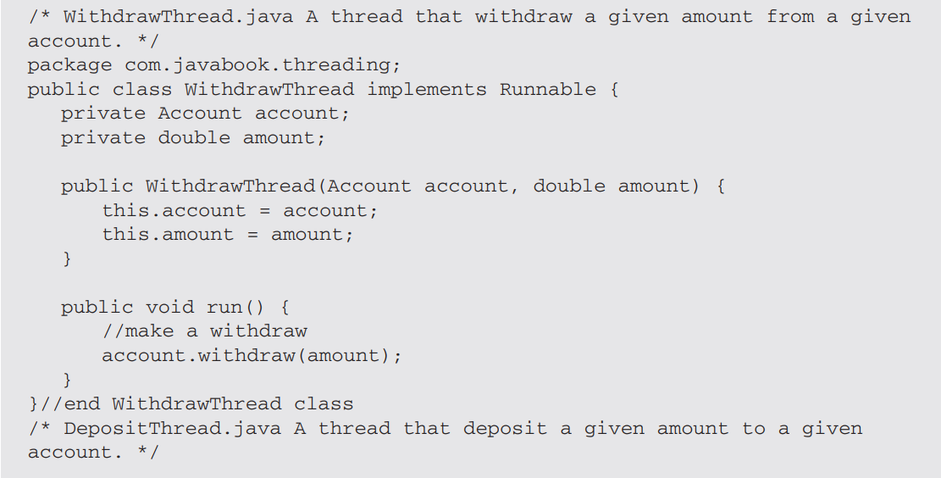
6 Threads sharing the same object

Slide 59
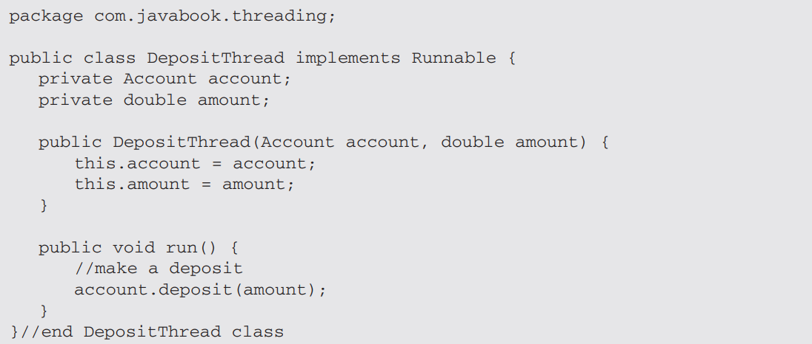
6 Threads sharing the same object

Slide 60
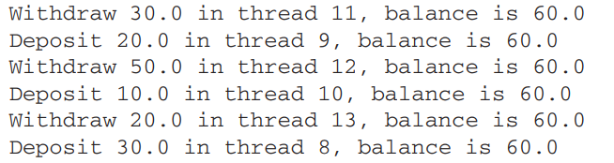
6 Threads sharing the same object: Unpredictable Behavior
Notes:
Run the InternetBankingSystem program again by removing the synchronized keyword; run may generate the following printout in the system console.
The balance of each transaction is totally unpredictable and wrong compared with the expected results

Slide 61
Monitor (shared object access): serializes operation on shared objects
class Account { // the 'monitor'
int balance;
// if 'synchronized' is removed, the outcome is unpredictable
public synchronized void deposit( ) {
// METHOD BODY : balance += deposit_amount;
}
public synchronized void withdraw( ) {
// METHOD BODY: balance -= deposit_amount;
}
public synchronized void enquire( ) {
// METHOD BODY: display balance.
}
}

Slide 62
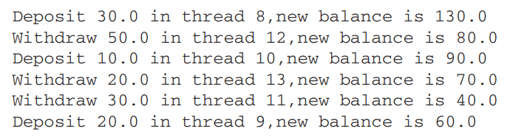
6 Threads sharing the same object: Predictable Behavior
Notes:
Run the InternetBankingSystem program again by removing the synchronized keyword; run may generate the following printout in the system console.
The balance of each transaction is totally unpredictable and wrong compared with the expected results

Slide 63
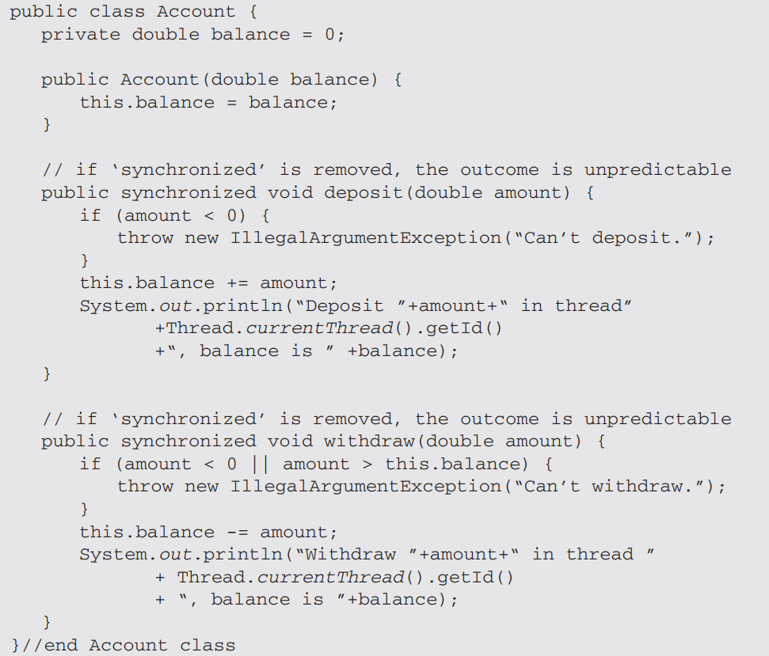

Slide 64
Architecture for Multithreaded Servers
Multithreading enables servers to maximize their throughput, measured as the number of requests processed per second.
Threads may need to treat requests with varying priorities:
A corporate server could prioritize request processing according to class of customers.
Architectures:
Worker pool
Thread-per-request
Thread-per-connection
Thread-per-object

Slide 65
Client and server with threads (worker-pool architecture)
Thread 2 makes
requests to server
Input-output
Receipt &
queuing
Thread 1
generates
results
T1
Requests
N threads
Client
Server
In worker-pool architectures, the server creates a fixed pool of worker threads to process requests.
The module “receipt and queuing” receives requests from sockets/ports and places them on a shared request queue for retrieval by the workers.

Slide 66
Alternative server threading architectures
Server associates a Thread with each connection and destroys when client closes the connection.
Client may make many requests over the connection.
Associates Thread with each object. An IO thread receives request and queues them for workers, but this time there is a per-object queue.
IO Thread creates a new worker thread for each request and worker thread destroys itself after serving the request.

Slide 67
Invocations between address spaces

Slide 68
Summary
Operating system provides various types of facilities to support middleware for distributed system:
encapsulation, protection, and concurrent access and management of node resources.
Multithreading enables servers to maximize their throughput, measured as the number of requests processed per second.
Threads support treating of requests with varying priorities.
Various types of architectures can be used in concurrent processing:
Worker pool
Thread-per-request
Thread-per-connection
Thread-per-object
Threads need to be synchronized when accessing and manipulating shared resources.

Slide 69
References
CDK Book (Text Book)
Chapter 7 – “Operating System Support”
Chapter 14: Multithread Programming
R. Buyya, S. Selvi, X. Chu, “Object Oriented Programming with Java: Essentials and Applications”, McGraw Hill, New Delhi, India, 2009.

